Slide 1

FINAL PROJECT

Slide 2

ONLINE BANKING SYSTEM

Slide 3

AGENDA
ALL TOPICS
TEST CASES
TEST SCENARIOS
SRS DOCUMENT
TEST PLAN
HTML AND CSS
JAVA
SELENIUM IDE
SELENIUM MARVEN PROJECT
ABOUT

Slide 4

ABOUT

Slide 5
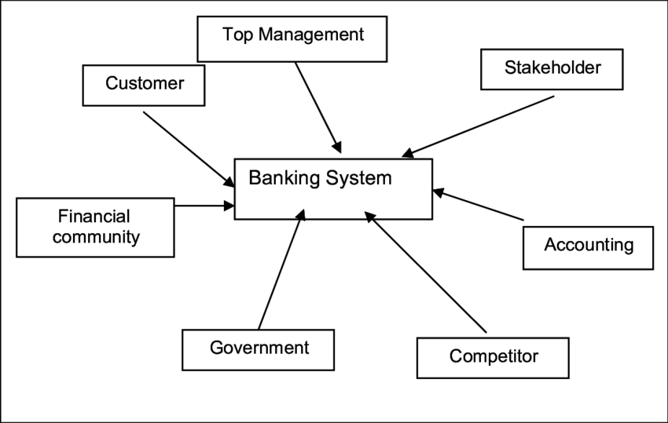
ABOUT
Online banking, also known as internet banking, web banking or home banking, is an electronic payment system that enables customers of a bank or other
financial institution to conduct a range of financial transactions through the
financial institution's website.
The online banking system will typically connect to or be part of the core banking system operated by a bank to provide customers access to banking services in place of traditional branch banking.
Online banking significantly reduces the banks' operating cost by reducing reliance on a branch network and offers greater convenience to customers in time saving in coming to a branch and the convenience of being able to perform banking transactions even when branches are closed.
Internet banking provides personal and corporate banking services offering features such as viewing account balances, obtaining statements, checking recent transactions, transferring money between accounts, and making payments.

Slide 6

ALL TOPICS

Slide 7
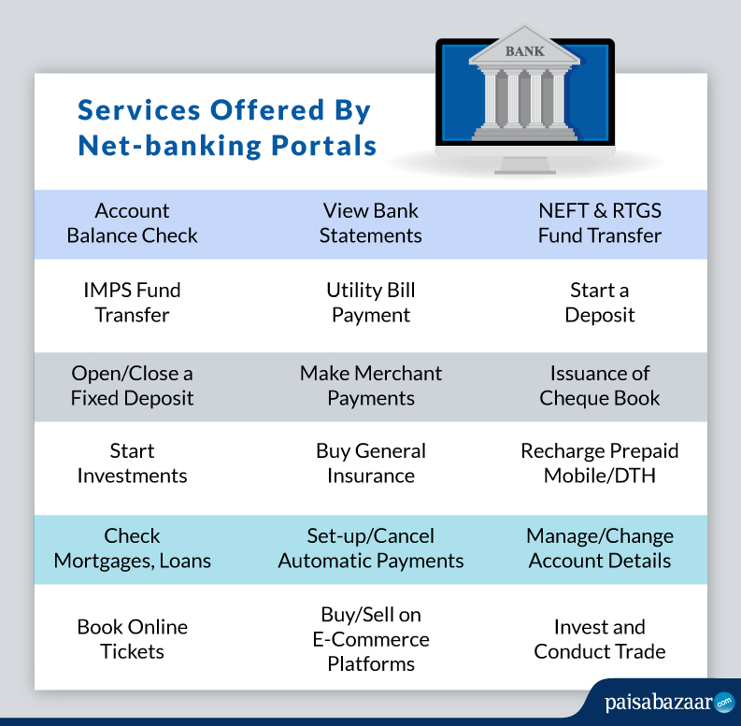
First online banking services by region
The United Kingdom
The United States
France
Japan
China
Australia
India
Brazil
Slovenia
Canada
Ukraine
Νorth Macedonia
Cook Islands

Slide 8
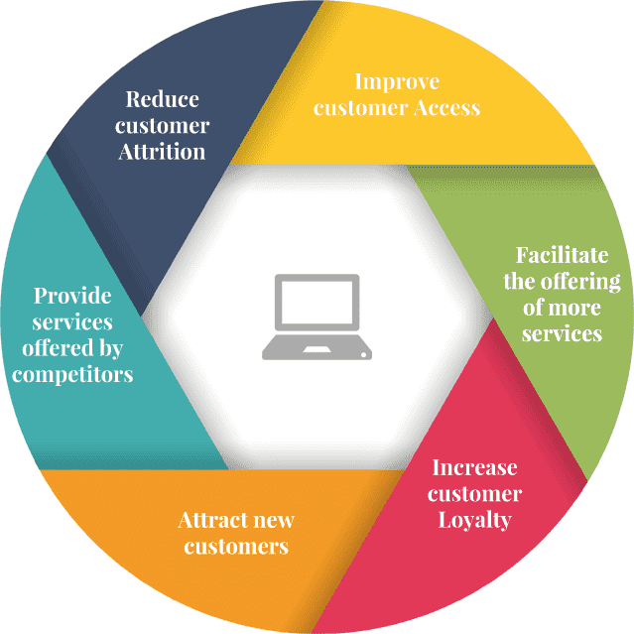
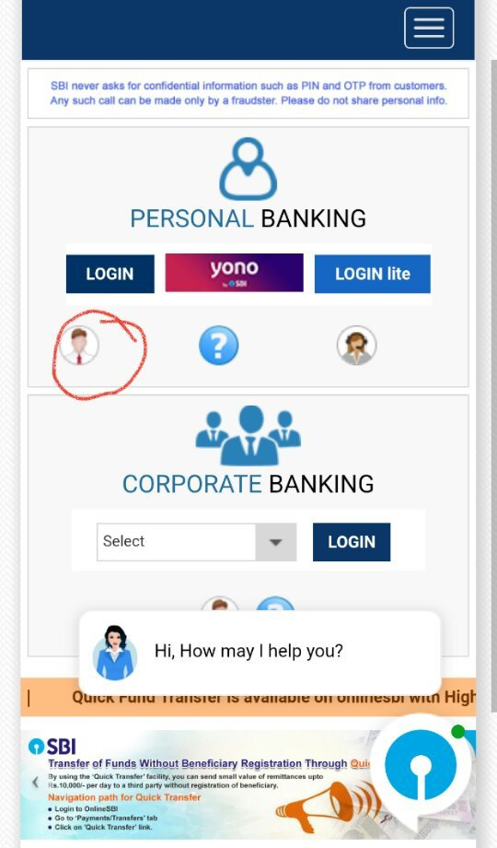

Internet banking solution essentially supports two types of transactions:
Financial transactions :
which involve inter and intra bank money fund transfers as in the case of third-party transfers, NEFT, bill payments etc.
Non-financial transactions :
which deal with provision of account information such as account balance, printing bank statements, even opening an account etc.

Slide 9
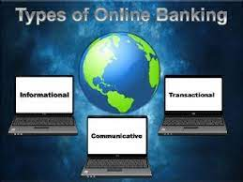
Key Takeaways:
Internet banking gives you access to various types of banking services online.
Most banks provide three different types of internet banking services.
Informational Internet Banking includes information on various products and services offered by banks.
Communicative Internet Banking allows you to perform simple transactions like applying for loans, checking balances, etc.
Transactional Internet Banking enables you to transfer funds and make payments.
Types of Internet Banking:
The different types of internet banking services are based on various levels of facilities offered by banks.
Basic Level or Informational Internet Banking
Intermediary or Communicative Internet Banking
Advanced or Transactional Internet Banking

Slide 10
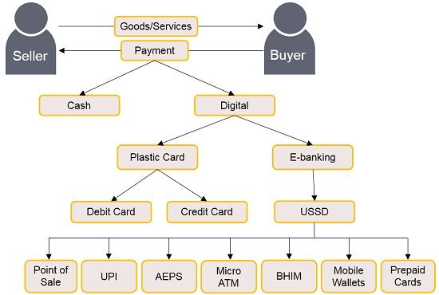
Basic Level or Informational Internet Banking:
The basic level refers to a bank’s website, which provides information on various products and services it offers.
You, as a customer, get limited access to general information available on the website and can send queries for detailed information via email.
Typically, informational internet banking encompasses the basic banking provisions like the various types of accounts, loan offerings, priority banking facilities, real estate projects affiliated with the bank, nearest bank branch and ATM locations, etc.

Slide 11
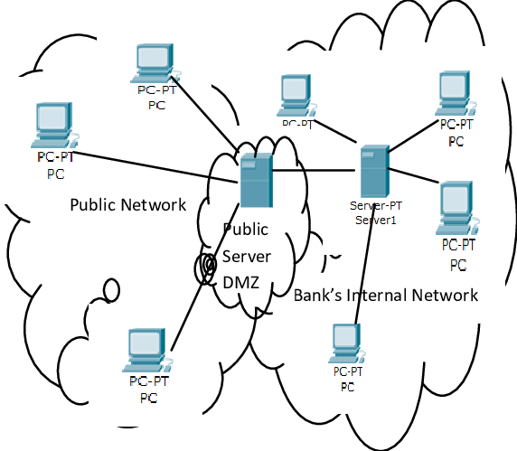
2. Intermediary or Communicative Internet Banking:
In this type of internet banking service, banks allow you to perform simple functions such as applying for various services like loans and raising queries regarding your account balances.
Communication between the bank and the customer takes place via virtual chatbots.
These chatbots are equipped to provide you with general information and redirect you to the customer care department if needed.
You can make general inquiries about minimum balance requirements, fund transfers, types of bank accounts and cards provided, etc.
Chatbots also answer basic queries such as types of loans available, interest rates and tenures on loans, and so on.

Slide 12
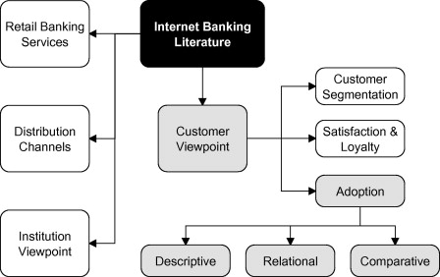
3.Advanced or Transactional Internet Banking:
Transactional Internet Banking is the type of internet banking service that deals with all the money-based or payment transaction services.
You typically need an active internet banking account and password to conduct money-based transactions like fund transfers, credit card bill payments, utility bill payments, creating term deposits, and investing in market securities.
Transactional internet banking has streamlined fund transfers in India by introducing facilities like National Electronic Fund Transfer (NEFT), Real Time Gross Settlement (RTGS), and Immediate Payment Service (IMPS).
These fund transfer channels enable instant fund transfers with varying minimum and maximum transaction limits.

Slide 13

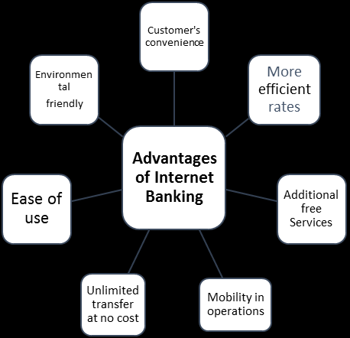
No Cashless Deposit Option.
There is no provision for cash deposits.
Internet Requirement.
Your access to Internet banking services can be hindered in the absence of a stable internet connection.
Internet Fraud.
Not as personal
Not able to access without technology.
Decrease in safety.
Increase in risk for fraud.
Doubtful data security on the internet.
Pay bills online.
Transfer money.
Deposit cheques online.
Lower your overhead fees.
Technology disruptions.
Lack of a personal relationship.
Privacy and security concerns.
Limited services.
Cost planning more reliable.
Total cost of ownership decreased.
Reaction time reduced
One single business partner.

Slide 14

TEST CASES

Slide 15

TEST CASES
BANK FUNCTIONALITY:
ADMIN FUNCTIONALITY
BRANCH FUNCTIONALITY
ACCOUNT OPENING NEW ACCOUNT FUNCTIONALITY
MONEY TRANSFER (ONLINE)
ACCOUNT

Slide 16


Slide 17
TEST SCENARIOS
TYPES OF SCENARIOS:
There are two types. They are:
Traditional banking sector
Service based banking sector
Sample test cases:
For Admin
For new Branch
For New Role
For customer & Visitors
For New users

Slide 18

SRS DOCUMENTATION

Slide 19
SRS DOCUMENTATION
1. Introduction
1.1. Purpose
1.2. Scope
1.3. Definition & Abbreviation
1.4. References
2. General Description
2.1. Product Perspective
2.2. Functionalities
2.2.1. Online balance check and transaction information
2.2.2. Save or view up to 1 year past history of transaction
2.2.3. Balance transfer
2.2.4. Online record Entry
2.2.5. Online record search
2.2.6. Online Billing option
2.2.7. Check book Allotment

Slide 20
2.3. User Characteristics
2.4. General Constraints
2.4.1. Hardware Requirements
2.4.2. Safety and Security
2.5. Assumptions & Dependencies
3. Specific Requirements
3.1. Functional Requirements
3.1.1. Context Diagram Extent List
3.1.2. Data Flow Diagram
3.1.3. Process Specification
Customer login
Bank features
Order for an account
Fill the form
Welcome page
Staff login
7. Check the balance
8. Transfer balance
9. Account detail teller
10. Order cash book
3.2. External Interface Requirements
3.2.1. User Interface
3.2.2. Hardware Interface
3.2.3. Software Interface
3.2.4. Communication Interface
3.3. Non-Functional Requirements
3.4. Other Requirements
4. Possible Product Evolution
4.1. Credit Card Management
4.2. Interface Evolution
4.3. Technological Evolution

Slide 21

TEST PLAN

Slide 22
TEST PLAN
3 TEST CRITERIA
3.1Suspension Criteria
3.2 Exit Criteria
4 RESOURCE PLANNING
4.1 System Resource
4.2 Human Resource
5 TEST ENVIRONMENT
6 SCHEDULE & ESTIMATION
6.1 All project task and estimation
6.2 Schedule to complete these tasks
7 TEST DELIVERABLES
7.1 Before testing phase
7.2 During the testing
7.3 After the testing cycles is over
INTRODUCTION
1 TEST STRATEGY
1.1 Scope of Testing
1.1.1 Feature to be tested
1.1.2 Feature not to be tested
1.2 Test Type
1.3 Risk and Issues
1.4 Test Logistics
1.4.1 Who will test?
When will test occur?
2 TEST OBJECTIVE

Slide 23

HTML
AND
CSS

Slide 24
HTML AND CSS
<!DOCTYPE>:
It defines the document type, or it instruct the browser about the version of HTML.
<html > :
This tag informs the browser that it is an HTML document. Text between html tag describes the web document. It is a container for all other elements of HTML except <!DOCTYPE>
<head>:
It should be the first element inside the <html> element, which contains the metadata(information about the document). It must be closed before the body tag opens.
<body> :
Text between body tag describes the body content of the page that is visible to the end user. This tag contains the main content of the HTML document.
Heading tag:
Text between <h1> tag describes the first level heading of the webpage.
<h1>, <h2>, <h3>, <h4>, <h5>, <h6>
SYNTAX:
<h1>Heading no. 1</h1>
<h2>Heading no. 2</h2>
<h3>Heading no. 3</h3>
<h4>Heading no. 4</h4>
<h5>Heading no. 5</h5>
<h6>Heading no. 6</h6>

Slide 25
<br> Tag: br stands for break line, it breaks the line of the code.
<p> : Text between <p> tag describes the paragraph of the webpage.
SYNTAX:
<p>This is first paragraph.</p>
The href attribute in HTML:
The href attribute provides the hyperlink, and if it is blank, then it will remain in same page.
SYNTAX:
<a href = "..........."> Link Text </a>
EXAMPLE:
<a href="">This is a link</a>
<a href="https://www.javatpoint.com/html-anchor">This is a link</a>
Appearance of HTML anchor tag:
An unvisited link is displayed underlined and blue.
A visited link displayed underlined and purple.
An active link is underlined and red.
HTML Image:
HTML img tag is used to display image on the web page.
HTML img tag is an empty tag that contains attributes only, closing tags are not used in HTML image element.
SYNTAX:
<img src="good_morning.jpg" alt="Good Morning Friends"/>

Slide 26
1) src
It is a necessary attribute that describes the source or path of the image.
It instructs the browser where to look for the image on the server.
The location of image may be on the same directory or another server.
2) alt
The alt attribute defines an alternate text for the image, if it can't be displayed.
The value of the alt attribute describe the image in words.
The alt attribute is considered good for SEO prospective.
3) width
It is an optional attribute which is used to specify the width to display the image.
It is not recommended now. You should apply CSS in place of width attribute.
4) height
It h3 the height of the image.
The HTML height attribute also supports iframe, image and object elements.
It is not recommended now. You should apply CSS in place of height attribute.
SYNTAX:
<img src="animal.png" height="180" width="300" alt="animal image">
HTML Form:
An HTML form is a section of a document which contains controls such as text fields, password fields, checkboxes, radio buttons, submit button, menus etc.
An HTML form facilitates the user to enter data that is to be sent to the server for processing such as name, email address, password, phone number, etc. .

Slide 27
<FORM>:
It defines an HTML form to enter inputs by the used side.
<INPUT>:
It defines an input control.
SYNTAX:
1.<form>
//Form elements
</form>
2.< form>
First Name: <input type="text" name="firstname"/> <br/>
Last Name: <input type="text" name="lastname"/> <br/>
</form>
3. <input type="text" name="username">
4. <input type="password" id="password" name="password"/>
5. <input type="email" id="email" name="email"/>
6. <input type="radio" id="gender" name="gender" value="male"/>Male
7. <input type="radio" id="gender" name="gender" value="female"/>Female
Submit button control
HTML <input type="submit"> are used to add a submit button on web page.
When user clicks on submit button, then form get submit to the server.
Syntax:<input type="submit" value="submit">

Slide 28
HTML Form Action
The action is an attribute of <form> element that specifies the URL of the second web page.
The second page receives the form-data from the first page after the submission of a form.
Syntax: <form action="URL of page"> .............. </form>
This attribute specifies the URL of a web page as its value which receives the information of the form filled by the user.
<form action="server url" method="get|post">
//input controls e.g. text field, text area, radio button, button
</form>
CSS Background-color:
This property is used to set the background color of an element. The background of an element covers the total size, including the padding and border and excluding margin. It can be applied to all HTML elements.
Syntax:
element {
background-color: color_name|transparent|initial|inherit;
}
Let's discuss the possible values of this property.
color name: It is used for defining the background color value or the color codes. It can be given by using the color name, hexadecimal value, or rgb() value.
transparent: It is the default value of this property, which is used to specify the transparent background-color.
initial: It is not used to set the background color. It sets the default value.
Inherit: It is used to inherit the background-color from its parent.

Slide 29
CSS background-attachment property:
This property has three values scroll, fixed, and local.
Its default value is scroll, which causes the element to not scroll with its content.
The local value of this property causes the element to scroll with the content.
If we set the value to fixed, the background image will not move during scrolling in the browser.
Syntax: background-attachment: scroll | fixed | local | initial | inherit;
The values of this property are defined as follows.
Property Values:
scroll: It is the default value that prevents the element from scrolling with the contents but scrolls with the page.
fixed: Using this value, the background image doesn't move with the element, even the element has a scrolling mechanism. It causes the image to be locked in one place, even the rest of the document scrolls.
local: Using this value, if the element has a scrolling mechanism, the background image scrolls with the content of the element.
initial: It sets the property to its default value.
inherit: It inherits the property from its parent element.
*:
This is used to apply background color.
It will only apply background color.

Slide 30

JAVA

Slide 31
JAVA
PACKAGE:
It is a package where our fills will be located.
In this we will be storing all the related in single package.
EXAMPLE: package final_project
JAVA STATIC IMPORT:
The static import feature of Java 5 facilitate the java programmer to access any static member of a class directly.
There is no need to qualify it by the class name.
EXAMPLE: import static java.lang.System.*;
import java.util.Scanner;
CLASS:
To write the code we have to create class name.

Slide 32
PRIVATE STRING:
Private is a Java keyword which declares a member's access as private.
That is, the member is only visible within the class, not from any other class (including subclasses).
The visibility of private members extends to nested classes.
PRIVATE LONG:
long is a primitive type, while Long is a Java class (and so it will inherit Object).
long must be assigned with a valid number, while Long can be null.
SCANNER:
A simple text scanner which can parse primitive types and strings using regular expressions.
A Scanner breaks its input into tokens using a delimiter pattern, which by default matches whitespace.
The resulting tokens may then be converted into values of different types using the various next methods.

Slide 33
PUBLIC VOID:
First public means that any other object can access it.
static means that the class in which it resides doesn't have to be instantiated first before the function can be called.
void means that the function does not return a value.
SYSTEM.OUT.PRINTLN():
System.out.println() is a statement which prints the argument passed to it.
The println() method display results on the monitor.
EXAMPLE: System.out.println("Hello!");
Java Scanner next() Method:
The next() is a method of Java Scanner class which finds and returns the next complete token from the scanner which is in using.
There are three different types of Java Scanner next() method which can be differentiated depending on its parameter.

Slide 34
Sc.nextlong():
The nextLong() is a Java Scanner class method which is used to scan the next token of the input as a long.
There is two different types of Java nextLong() method which can be differentiated depending on its parameter.
Java if-else Statement:
The Java if-else statement also tests the condition.
It executes the if block if condition is true otherwise else block is executed.
Syntax: if(condition){
//code if condition is true
}
else{
//code if condition is false
}

Slide 35
PUBLIC BOOLEN SEARCH():
Build a Boolean search string for Java developers according to your needs:
-job -jobs -sample -examples, to avoid irrelevant results.
(in title: resume OR in title: cv), to discover candidates' online resumes or CVs.
RETURN TYPE:
A return type may be a primitive type like int, float, double, a reference type or void type(returns nothing).
The type of data returned by a method must be compatible with the return type specified by the method.
Public static void main(String arg[]) { :
public static void main(String[] args) Java main method is the entry point of any java program.
Its syntax is always public static void main(String[] args) .
You can only change the name of String array argument, for example you can change args to my String Args .

Slide 36
sc.nextInt():
The nextInt() method scans the next token of the input data as an “int”.
As the name of the class Scanner elaborates, nextInt() method of this class is used to scan or parse the input.
INT:
An int is a data type that stores 32-bit signed two's compliment integer.
On other hand Integer is a wrapper class which wraps a primitive type int into an object.
Purpose. int helps in storing integer value into memory.
FOR:
Syntax:
for (statement 1; statement 2; statement 3) { // code block to be executed }
Statement 1 is executed (one time) before the execution of the code block.
Statement 2 defines the condition for executing the code block.
Statement 3 is executed (every time) after the code block has been executed.

Slide 37
DO-WHILE:
The Java do-while loop is used to iterate a part of the program repeatedly, until the specified condition is true.
If the number of iteration is not fixed and you must have to execute the loop at least once, it is recommended to use a do-while loop. Syntax:
do{
//code to be executed.
}while(true);
SWITCH CASE:
Syntax:
switch(expression)
{ case x: // code block break;
case y: // code block break;
default: // code block }
This is how it works:
The switch expression is evaluated once.
The value of the expression is compared with the values of each case.
If there is a match, the associated block of code is executed.
The break and default keywords are optional, and will be described later in this chapter

Slide 38

SELENIUM IDE

Slide 39
SELENIUM IDE
STEP BY STEP PROCESS:
OPEN SELENIUM IDE
SELECT RECORD A NEW TEST IN A NEW PROJECT
ENTER PROJECT NAME
CLICK OK
ENTER TEST URL
CLICK OK
CLICK ON START RECORDING
RECORD BY CLICKING AND SCROLLING
CLICK ON STOP RECORDING
RUN THE TEST CASE

Slide 40


Slide 41
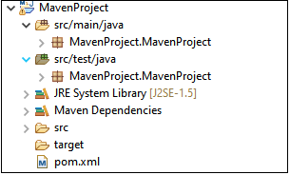
SELENIUM MARVEN PROJECT
STEP BY STEP PROCESS:
OPEN ECLIPSE
SELECT NEW PROJECT
CLICK ON SEARCH
TYPE MARVEN PROJECT
CLICK ON NEXT
SELECT CREATE A SIMPLE PROJECT
CLICK ON NEXT
ENTER THE GROUP ID, ARTIFACT ID, PACKAGE
CLICK ON FINISH
FINALLY MARVEN PROJECT IS ADDED

Slide 42


